Slide 1
IT Governance

Slide 2
A video
Question to be answered….
What are the basic roles of a governing body?

Slide 3
What is Governance?
“Governance is the act of governing. It relates to decisions that define expectations, grant power, or verify performance. It consists of either a separate process or part of decision-making or leadership processes… In the case of a business or of an NGO, governance relates to consistent management, cohesive policies, guidance, processes and decision-rights for a given area of responsibility. For example, managing at a corporate level might involve evolving policies on privacy, on internal investment, and on the use of data.”
Wikipedia

Slide 4
Ok…Now what is IT Governance?
Let’s answer this by looking at what’s going on right now…

Slide 5
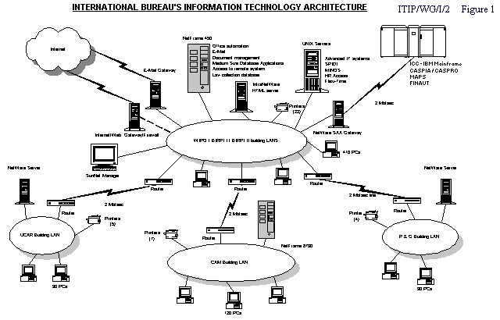
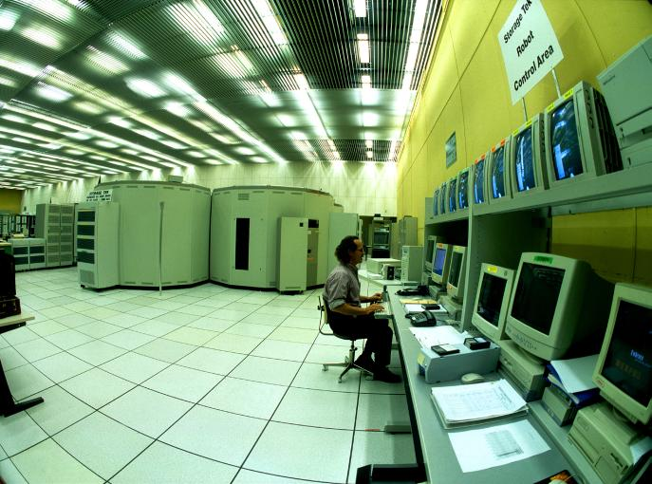
Managing Ever-Increasing Complexity

Slide 6

















The Business World View
Identity Manager
SAP
PSFT
Siebel
Network
Firewall
Load Balancer
Portal
Mainframe
Black Box
Router
Switch
Database
Web Servers
Applications
End User
Web Services
Databases
3rd Party applications

Slide 7
The Cruel Reality
Application
Screen
Scrape
Message
Download
Application
Application
Queue
File
Application
Screen
Scrape
Sockets
Transaction
Screen
Transaction
File
Scrape
File
Application
Download
CICS Gateway
Sockets
File
RPC
ORB
Application
APPC
ORB
Message
Application
Application
Message
Transaction
Queue
Application
File
Message
CICS Gateway
Queue
Transaction
Screen
File
Scrape
Message
Download
APPC
RPC
Application
File

Slide 8
Addressing These Challenges: Improving Engagement (Effectiveness) and Efficiency
WHAT IS ENGAGEMENT?
Doing the Right Things
WHAT IS EFFICIENCY?
Doing Things Right
IT’s ability to partner with the business to maintain alignment and maximize return from IT investments
IT’s ability to make the best use of its people, budgets and assets

Slide 9






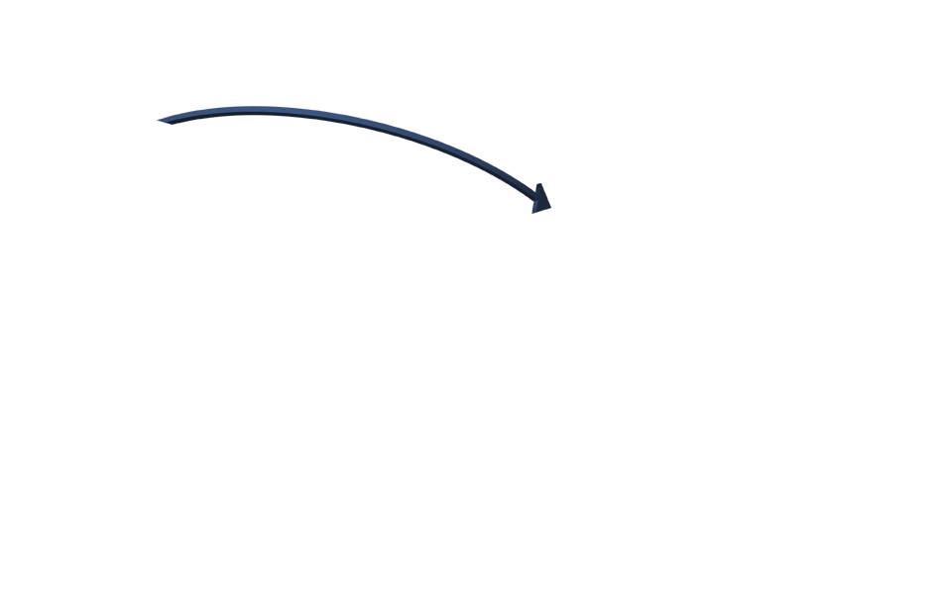





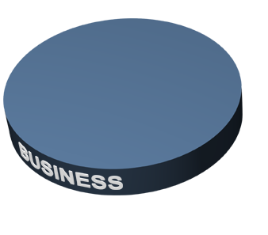
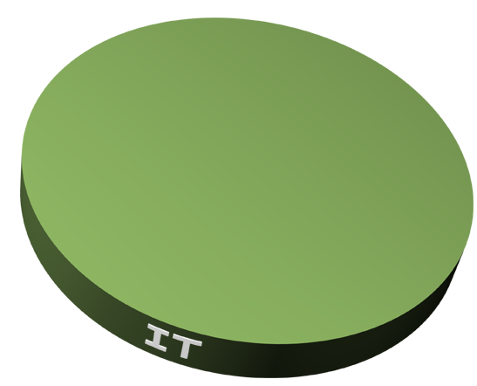
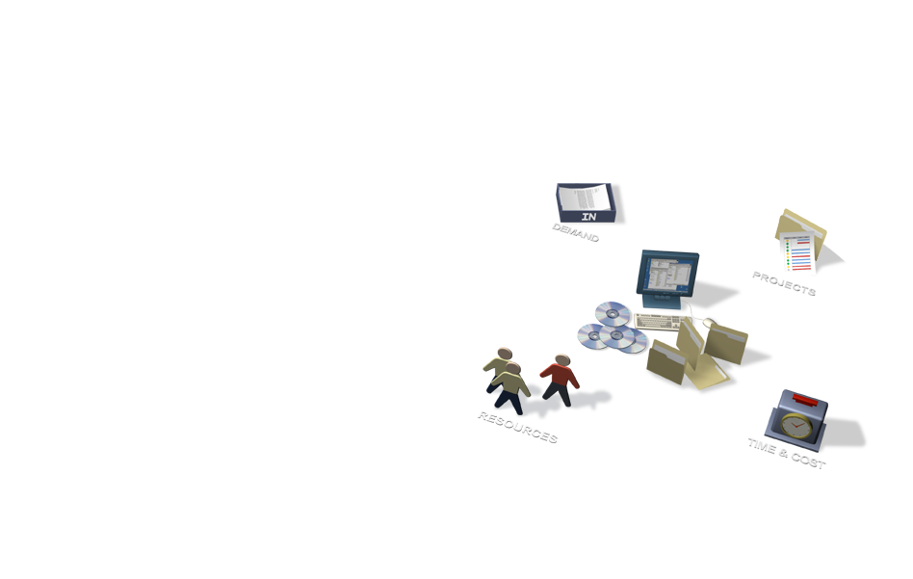


Obstacles Prevent Effective(ness) Engagement
$
$
$
Overwhelming Demand:
Unstructured capture of requests and ideas
No formal process for prioritization and trade-offs
Reactive vs. proactive
IT and Biz Divide
Business thinks in IT services – IT delivers in technology terms
Costs disassociated with services
IT Seen as Black Box:
Business lacks visibility
Poor customer satisfaction

Slide 10
















Disparate Systems Reduce Efficiency
No Single System of Record for Decision-Making
IT Management systems siloed
Relevant Metrics Hard to Obtain
Disparate Systems Costly to Maintain and Upgrade

Slide 11
So, where does IT Governance come in?
IT governance may be presented as the organizational capacity to control the formulation, valuation and implementation of IT strategy, tightly aligned with business strategy, and as a guide to proper direction for the purpose of achieving the business goals of the enterprise.
Simply put, IT governance is a combination of processes, practices, rules and relationships. To be effective and successful, IT governance has to be practiced in all circumstances, with attitudes favoring negotiation, diplomacy and communication, to be perceived as a true and active facilitator.

Slide 12

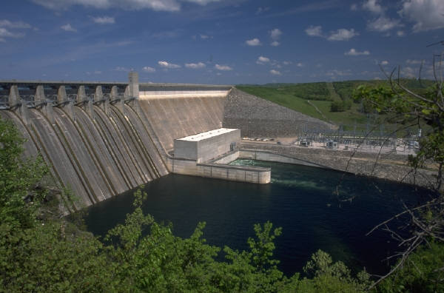
IT Governance
If we were to simplify it … It is the management of risk & compliance.
“The overall methodology by which IT is directed, administered and controlled”
Governance
Compliance

Slide 13
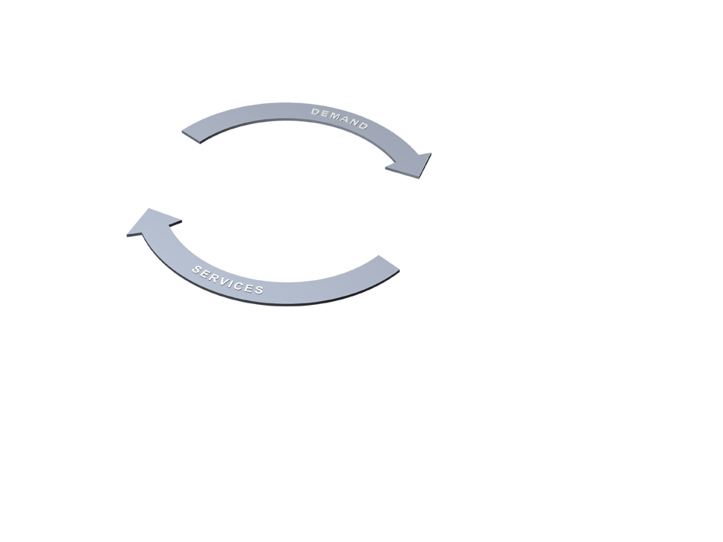
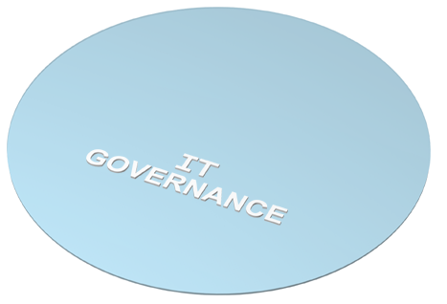








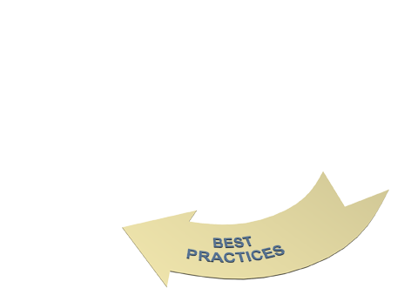








IT Governance Landscape

Slide 14

How to Improve Engagement? Structured IT Governance Process
Integrated Demand Management
Capture, catalog, and prioritize all demand
Manage service requests from help desks
Match resources to highest-value initiatives
Comprehensive Portfolio Management
Services, projects, assets, applications
Systematic evaluation and prioritization
Map controls to compliance requirements
100% visibility into strategic initiatives
A single invoice to the customer for all services
Business Intelligence
Visibility into all services that support LOB
Detailed cost invoices

Slide 15
How to Improve Efficiency? Comprehensive Management
Empower the PMO
Automate, enforce, and report on process compliance
World-Class Project Execution
Leverage best practices across entire project portfolio
Rapid time to value
Comprehensive Resource Management
Drive maximum utilization of in-house and outsourced resources
Capture time and allocate staff for any type of investment
Advance Resource Mgmt capabilities
Scalable, Transparent Status Capture
Capture time and cost of all activities in a single repository for charge-backs and reporting
Capture asset costs through integration with Asset Management Solution

Slide 16
Effective IT Governance: Key Issues
What are the components of top level IT governance
How can these components be represented?
When and where are different types of IT governance arrangements effective?
How can you show the linkages between your enterprise goals and IT governance?
How can you improve your IT governance?
The research
MIT Sloan CISR Study, led by Peter Weill, with Gartner EXP*
250+ Gartner EXP members, 23 countries
Complex enterprises, demanding business environments
Notes:
Much greater clarity is required in the components of IT governance and in understanding how they are effective.
Source: MIT Sloan CISR and Gartner EXP Research
What is IT governance and why is it critical?
Understanding effective IT governance requires understanding its components, how they can be represented and what makes for effective IT governance. Most views on governance are based on anecdotal evidence. To bridge that gap Gartner’s CIO Executive Programs (EXP) group worked with MIT Sloan Center for Information Systems Research (CISR) in a major research study.
The research base for this presentation is from an MIT Sloan CISR project led by Dr. Peter Weill, director of CISR, with input from Gartner’s EXP group, led by Dr. Marianne Broadbent. Gartner organized and facilitated data collection and case study development with Gartner EXP members. The research was made possible by the support of CISR sponsors and, in particular, CISR patron Gartner. The enterprises studied were complex with demanding business environments and IT investments. On average, they had eight different business units, spent 8 percent of expenses annually on IT across their enterprises, and employed 800 full-time IT professionals. The results are scheduled to be published in the January 2003 Gartner EXP Premier Report, Effective IT Governance – by Design, by Marianne Broadbent and Peter Weill.

Slide 17
IT governance has 3 major components
What decisions need to be made? . . . Decisions about major IT domains
Who has decision and input rights? . . . Rights are exercised in different governance styles
How are the decisions formed and enacted? . . . Multiple mechanisms make governance work
Notes:
What are the components of top-level IT governance?
Governance processes involve decisions about major IT domains, that is, those areas, such as IT investment, IT principles or maxims. They balance decision rights between multiple constituencies, such as “C-level” executives (including the CIO), business unit leaders and IT executives. Their purpose is to encourage desirable behavior so the enterprise achieves its goals. IT governance is formed and enacted by multiple mechanisms – formal mechanisms, such as the executive committee and the IT council, and informal mechanisms, such as talking with colleagues.
IT governance is going through a time of considerable change. Research from the MIT Sloan/Gartner EXP study shows that governance is dynamic with enterprises making regular changes.
Effective IT governance arrangements thoughtfully and purposefully combine decision making about major IT domains, by the right group of people, using appropriate mechanisms.
Source: MIT Sloan CISR

Slide 18
A: What decisions need to be made? . . Clarify five major IT decision domains
IT principles
High level statements about how IT is used in the business
IT infrastructure strategies
Strategies for the base foundation of budgeted-for IT capability (both technical and human), shared throughout the firm as reliable services, and centrally coordinated (e.g., network, help desk, shared data)
IT architecture
An integrated set of technical choices to guide the organization in satisfying business needs. The architecture is a set of policies and rules that govern the use of IT and plot a migration path to the way business will be done (includes data, technology, and applications)
Business
application needs
Business applications to be acquired or built
IT investment and prioritization
Decisions about how much and where to invest in IT including project approvals and justification techniques
Notes:
What are the components of top-level IT governance?
IT governance involves decisions about five major IT domains: 1) IT principles (or maxims) are high-level statements about how IT will be used to create business value. They should be informed by the enterprise business maxims. 2) IT infrastructure strategies describes the approach to building shared and standard IT services across the enterprise. 3) IT architecture is about the set of technical choices that guide the enterprise in satisfying business needs. In case of J&J, this means development of some agreed components of data architecture so that customer information can be meaningfully shared, together with selected standards to support the agreed architectural approach. 4) Business applications needs refer to applications that need to be acquired or built. 5) IT investment and prioritization covers the process of IT investment, including where they should be focused and the procedures for progressing initiatives, their justification, approval and accountability. (Adapted from Weill and Woodham 2002.)
Action Item: Articulate and clarify the five major IT domains that provide the foundation and guidance for IT-enablement across the enterprise.
IT governance is about clarifying the decision and input rights for five major IT domains.
Source: MIT Sloan CISR

Slide 19


B. Who has decision rights and inputs? . . Rights exercised in six governance styles
Style
Who makes the decisions?
Business Monarchy
C-level executives, as a group or individuals, including the CIO (but not acting independently)
IT
Monarchy
Individuals or groups of IT executives
Feudal
Business unit leaders or their delegates
Federal
C-level executives and at least one other business group
Duopoly
IT executives and at least one other business group
Anarchy
Each individual business process owner or end user
Notes:
What are the components of top level IT governance?
IT governance defines who has input and who makes the decisions. There are six styles of corporate governance and information politics:
1) Business monarchy where the executive leadership has decision rights. These are often exercised through an executive committee or IT Council comprising a combination of business and IT executives.
2) IT monarchy where IT executives have the decision rights. These are often exercised through an IT Leadership Council or CIO office.
3) Feudal where business unit leaders or their delegates have the decision rights and authority is localized. This style is found in enterprises with relatively autonomous business units and can be useful in delivering local responsiveness.
4) Federal where governance rights are shared by C level executives and at least one other business group. This style is often used for inputs to decisions rather than the group which actually takes the decisions.
5) Duopoly where rights are shared by IT executives and at least one other business group
6) Anarchy where individual process owners or end users have decision rights and there are usually no formal mechanisms for exercising rights. Decisions are made ad-hoc and locally.
Different styles can be used for each of the five IT domains. (Adapted from Weill and Woodham 2002)
Action Item: Use the lens of corporate governance and information politics to depict key governance styles and the locus of decision rights.
Corporate governance and the language of information politics are useful lenses
for depicting the major players and approaches in enterprise IT governance.
Source: MIT Sloan CISR

Slide 20
Another Perspective as to who has the decision rights….
Today's companies are running global businesses or trying to make their businesses more global. In response, IT organizations are expected to become more global. Two distinct types of global IT organizations:
Centralized, in which the global CIO has direct authority over all IT resources, and
Decentralized, in which IT resources report to local or regional business management. or a global business unit and have "dotted-line" reporting to a global CIO.

Slide 21
Different Leadership Styles resulting in the second perspective..
The different levels of CIO authority and resources require different leadership styles. In the centralized model, the global CIO retains ultimate accountability over strategy and budgets, project portfolio, staff, major suppliers and senior executive reporting.
In the decentralized model, the global CIO has no direct responsibility over the sometimes numerous local CIOs and their organizations. Here, the only smart way to lead is through a facilitated leadership style, with the CIO creating forums where group CIOs can come together to share best practices, debate issues and agree on common approaches.

Slide 22
C. How are the decisions formed, enacted? . . Many mechanisms make governance work
Governance mechanisms Objective
Executive committee Take a holistic view
IT council of business, IT executives Focus on driving value
IT leadership committee Coordinate across the enterprise
Architecture committee Identify strategic technologies
Business/IT relationship managers Ensure feedback, good iteration
Process teams with IT members Take a process view
Service-level agreements Specify, measure IT services
Chargeback arrangements Shape behavior, recoup costs
Notes:
What are the components of top-level IT governance?
Governance mechanisms are the vehicles used to implement different governance styles. They might be specific to one IT domain or cover multiple domains.
The executive committee often constitutes a mechanism in that major decisions about IT-enabling the enterprise are taken at that or the board level. This encourages a holistic view, but unless there is top-level IT input, there is the risk that the decisions might not be well informed. IT councils often report in to the executive committee and contain overlapping memberships. Such councils can provide a focused environment to consider several levels of policies and investments. IT leadership councils are particularly important for large multibusiness enterprises where there is a mix of responsibilities for infrastructure services, some enterprisewide and others at business-unit level. Architecture committees can involve business and IT management in defining the architectural guidelines. Business/IT relationship managers are prevalent in many enterprises but with a variety of names. They play a critical role on a daily basis in understanding how the business operates and in interacting with their business peers.
Action Item: Understand the different mechanisms that can be used to implement effective IT governance.
Enterprises use multiple mechanisms to help implement their IT governance arrangements.
Source: MIT Sloan CISR (Weill and Woodham); Broadbent and Weill

Slide 23
A video
Question: Watch the video and try to relate it to the three major components of IT Governance.

Slide 24
How to represent IT governance arrangements?
IT Governance Arrangements Matrix
Domain
IT principles
IT infra- structure
strategies
IT architecture
Business
application needs
IT investment
Style
?
Business
Monarchy
IT
Monarchy
Feudal
Federal
Duopoly
Anarchy
Don’t Know
Notes:
How can enterprise IT governance patterns be represented?
A matrix can be used to depict governance arrangements by listing the six governance styles on the vertical axis and mapping them to the five IT domains on the horizontal axis.
The MIT Sloan CISR and Gartner EXP study identified how 250 enterprises made major decisions regarding who had decision rights and who had input about each of the five IT domains.
IT governance can be represented using an IT Governance Arrangements Matrix.
Source: MIT Sloan CISR

Slide 25
Drive enterprise-wide growth & change – a Bank
IT Governance Arrangements Matrix
Domain
IT principles
IT infrastructure
strategies
IT architecture
Business
application needs
IT investment
and prioritization
Style
Input
Decision
Input
Decision
Input
Decision
Input
Decision
Input
Decision
Business
Monarchy
Corp office
CIO
Corp office
CIO
Proj council
Corp office
IT
Monarchy
CIO
IT leaders
CIO
IT leaders
Arch office
CIO
Feudal
Federal
Biz leaders
Biz proc own
Duopoly
Biz leaders
IT leaders
Biz leaders
IT leaders
Biz leaders
IT leaders
BT managers
Input rights
Decision rights
Governance mechanisms
Corp office
Corporate office (CEO, CIO, 3 biz heads)
Proj council
Regional project councils
Arch office
Office of architecture
BT managers
Business technology relationship managers
CIO
CIO office and staff
Biz proc own
Business process owners
IT leaders
IT leadership group
Value realization process
Notes:
How can enterprise IT governance patterns be represented?
The leading Singapore bank, DBS, is actively using IT governance to bring about enterprise change.
DBS has won two awards for its enterprise governance in the past two years. In their IT governance DBS differ from typical patterns: they take a business monarchy approach to IT principles, have only IT monarchy input to IT infrastructure strategies and take a business monarchy approach to IT investment decisions.
At DBS there is no such thing as an IT project – they are all business change projects. Business unit heads have authority over tactical investments (up to $1 million including hardware, software, professional services and any internal people costs.) One of three regional Project Councils control investments between $1 – $5 million. The CIO chairs one of these councils and sits on the other two. A five member Corporate Office (including the CEO and CIO) handles anything over $5 million.
Every initiative is assessed on both financial and non-financial objectives such as revenue versus cost reduction and strategic, experimental or tactical considerations. Within the IT area, there’s a group of business technology relationship managers (called IT Lite) who report to the CIO. They manage the human and IT assets related to the prioritization process of each IT-related investment.
Once an initiative is approved, the Program Office is responsible for meeting with the project sponsor and tracking all the business case metrics. From 2003, there will be a formal link between benefits realization and reward mechanisms for program sponsors.
The ‘IT Governance Arrangement Matrix’ can be used to illustrate how governance styles, IT domains and governance mechanisms inter-relate.
Source: MIT Sloan CISR and Gartner EXP Research

Slide 26
High governance performers have sharper strategies, focus and commitment
Characteristics of high IT governance performers
More focused strategies
Greater differentiation between customer intimacy, product innovation, or operational excellence
Clearer business objectives for IT investment
Greater differentiation between supporting new ways of doing business, improving flexibility, or facilitating customer communication
High level executive participation in IT governance
Greater involvement, impact of CEO, COO, Business Heads, Business Unit CIOs and CFO
Who could accurately describe IT governance arrangements
Stable IT governance, fewer changes year to year
Well functioning formal exception processes
Formal communication methods
Notes:
When and where are different types of IT governance arrangements effective?
Enterprises with higher governance performance have more-focused strategies. They clearly differentiated between the three value disciplines – customer intimacy, product/service innovation or operational excellence – and were not trying to optimize on all three of these. On average, these enterprises had greater differentiation between different objectives for their IT investment. They were not expecting IT investments to excel in delivering on multiple objectives. Rather, they had specific focus on smaller number of objectives for their IT investment – whether it was lowering cost, supporting new ways of doing business, greater flexibility or facilitating customer communication.
Senior business leaders were more heavily involved in IT governance and there was a higher level of impact from the CEO, COO, business unit leaders, business unit CIOs and the CFO. More managers in leadership positions could accurately describe governance arrangements and there were fewer changes in IT governance, year on year.
Exception processes functioned more effectively in enterprises with higher governance performance. They were seen as more transparent and fair and there were fewer nonsanctioned exceptions.
High governance performance enterprises have both business strategies and IT investments strategies which were more focussed and differentiated.
Source: MIT Sloan CISR and Gartner EXP Research

Slide 27
Map IT governance to enterprise goals . . . Harmonize ‘what’ and harmonize ‘how’
What
What
ENTERPRISE GOALS
IT GOVERNANCE STYLE
PERFORMANCE MEASURES
Financial drivers
Business maxims
Decision rights for the five IT domains
Business performance indicators
How
How
How
DESIRABLE IT BEHAVIORS
IT GOVERNANCE MECHANISMS
IT METRICS & ACCOUNT-ABILITIES
Notes:
How can you show the linkages between your enterprise goals and IT governance?
Effective governance requires the harmonization of two types: harmonizing the “what” of governance (left-to-right arrows) and harmonizing the “how” (up-and-down arrows).
The “what” of governance includes enterprise goals, IT governance style and performance measures. Enterprise goals can be expressed as financial drivers and business maxims (Broadbent and Weill, 1997). IT governance style is about which of the six governance styles – business monarchy, IT monarchy, feudal, federal, duopoly and anarchy – are in place for the decision rights of each of the five IT domains – IT principles, IT infrastructure strategies, IT architecture, business application needs, and IT investment prioritization. Performance goals are the targets and time frames for delivery of the enterprise goals.
The “how” of governance includes desirable IT behaviors flowing from enterprise goals, the IT governance mechanisms in place, and IT metrics and accountabilities. (Adapted from Weill and Woodham, 2002.)
Action Item: Map enterprise IT governance so that the “trail of evidence” between enterprise goals, desirable behaviors, IT governance arrangements and performance measures is transparent.
Source: MIT Sloan CISR and Gartner EXP Research
Enterprises need to map their IT governance to identify how that governance is encouraging desirable behaviors and how it links to performance metrics.

Slide 28
Harmonized goals, styles and metrics . . . Regional Bank
ENTERPRISE GOALS
- Examples -
IT GOVERNANCE STYLE
- Examples -
PERFORMANCE MEASURES
- Examples -
Financial Drivers
- Growth
Business Maxims
- Greater customer focus
- Balance local/enterprise
- Speed, flexibility
Business Monarchy - IT principles - Biz application needs - IT investment
IT Monarchy decides - IT infrastructure - IT architecture
Quality of customer relationships
Bigger share of customer
Faster time to market
SAMPLE DESIRABLE IT BEHAVIORS
IT GOVERNANCE SAMPLE MECHANISMS
SAMPLE IT METRICS & ACCOUNTABILITIES
Enable high-level, consistent customer relationships
Treat all IT investments as business change projects
Build for future flexibility
Formal Corporate Office involvement Regional Project Councils - 3 tier approach
Investment in IT as a portfolio
Business technology relationship managers
Level of business ownership of projects
Penetration of franchise-wide platform
Level of common technology, common data definitions
Use of franchise-wide metrics
Notes:
How can you show the linkages between your enterprise goals and IT governance?
DBS has worked at getting greater harmony amongst both governance ‘whats’ – enterprise goals, IT governance and enterprise performance measures, and the ‘hows’ – linking desirable behaviors to enterprise goals, IT governance mechanisms to IT governance style and IT metrics and accountabilities to enterprise performance measures.
DBS has grown rapidly though acquisition and intends to continue to do so. It aims to become a leading Asian regional franchise and be one of the top five banks in five countries by 2005. To achieve this it has shifted from a strong product, to a strong customer orientation. It’s aim is to give 4 million retail clients, the same level of customer intimacy offered to private banking customers. IT is seen to play a critical role in that growth.
The combination of strategically shifting to a customer focus while acquiring other banks presents real challenges. DBS wants to drive synergies from the acquisitions, yet ensure local accountability. This means giving autonomy for the product mix to local business leaders while working towards consistency in processes and technologies.
The bank is building a franchise-wide platform with common technology, common data definitions and common metrics. This also enables it to gain the necessary synergies while simultaneously empowering the local business leaders to localize the customer experience. Rethinking and reworking their approach to IT architecture has been a major focus for DBS.
Source: MIT Sloan CISR and Gartner EXP Research
The ‘What-How’ Congruence Framework depicts how enterprise goals, governance style and performance measures are synchronized, and how goals are linked to behaviors, styles matched with mechanisms, and performance measures with IT metrics.

Slide 29
Recommendations which shape effective IT governance
Design IT governance thoughtfully
. . . Don’t have ‘governance by default . . . Carefully design IT governance for each IT domain
Focus on a few goals, desirable behaviors, and metrics
. . . Good governance requires choices to optimize
Educate executives: IT governance is important
. . . Without top level input, poor decisions are made . . . Good IT governance helps business executives achieve success
Notes:
How can you improve your IT governance?
Know the factors necessary for effective IT governance:
1) IT governance must be thoughtfully and actively designed.
2) A sharp focus on a limited number of goals, behaviors and metrics is necessary. Good governance requires choices. You can’t optimize on multiple options.
3) Educating executives and managers about why governance is important is a constant challenge and requirement. Good behaviors must be reinforced and inappropriate behaviors redirected.
4) Without transparency, there is not trust. Transparency must be built in to IT governance so that is confidence in the processes. This includes clear exception handling processes, with transparent and rapid escalation processes. Exceptions are how enterprises learn.
5) Acknowledge that changing governance can take months. Make changes only when desirable behaviors change markedly.
Action Item: Communicate and act on the factors that shape effective IT governance.
‘Don’t Just Lead, Govern! . . . Governance leverages the ingenuity of all the enterprise’s people, not just the leaders, while ensuring compliance with the overall vision and principles.’ . . . P. Weill, 2002
Source: MIT Sloan CISR

Slide 30
Recommendations which shape effective IT governance
Build transparency into your governance arrangements
. . . More transparency => more confidence
Change IT governance to change behaviors
. . . Shifts need to occur when strategy changes . . . New arrangements takes time to communicate, implement
Notes:
How can you improve your IT governance?
Know the factors necessary for effective IT governance:
1) IT governance must be thoughtfully and actively designed.
2) A sharp focus on a limited number of goals, behaviors and metrics is necessary. Good governance requires choices. You can’t optimize on multiple options.
3) Educating executives and managers about why governance is important is a constant challenge and requirement. Good behaviors must be reinforced and inappropriate behaviors redirected.
4) Without transparency, there is not trust. Transparency must be built in to IT governance so that is confidence in the processes. This includes clear exception handling processes, with transparent and rapid escalation processes. Exceptions are how enterprises learn.
5) Acknowledge that changing governance can take months. Make changes only when desirable behaviors change markedly.
Action Item: Communicate and act on the factors that shape effective IT governance.
‘Don’t Just Lead, Govern! . . . Governance leverages the ingenuity of all the enterprise’s people, not just the leaders, while ensuring compliance with the overall vision and principles.’ . . . P. Weill, 2002
Source: MIT Sloan CISR

Slide 31
Best Practices
What is not defined cannot be controlled
What is not controlled cannot be measured
What is not measured cannot be improved
Quality & Control Models
ISO 900x
COBIT®
TQM
EFQM
Six Sigma
COSO
Deming
etc..
Process Frameworks
ITIL®
Application Service Library
Gartner CSD
IBM Processes
EDS Digital Workflow
Microsoft MOF
Telecom Ops Map
etc..

Slide 32
A Video
Question: Watch the video and relate how the California CIO’s presentation matches to any of the five key issues discussed in class

